Slide 1



LI Detector: Measuring Small Fitness Effects in High Throughput
Saurin Parikh
Integrative Systems Biology Program
PI: Anne-Ruxandra Carvunis
Department of Computational and Systems Biology
Pittsburgh Center for Evolutionary Biology and Medicine
University of Pittsburgh School of Medicine
Notes:
Good afternoon fellow evolutionary biologists.
My name is Saurin Parikh and I am a doctoral student in Anne-Ruxandra Carvunis’ lab within the Department of Computational & Systems Biology at the University of Pittsburgh School of Medicine.
Today I am going to introduce to you the LI Detector, a bioinformatic tool we developed to measure small fitness effects in high-throughput.

Slide 2
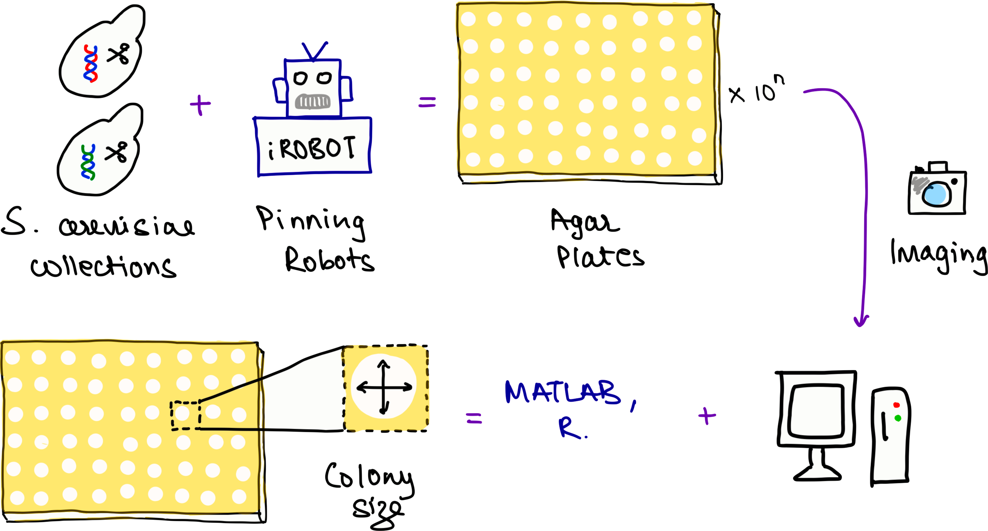



Colony-based high-throughput screens (CBHTS)
@saur1n
Notes:
Colony-based high-throughput screens have become increasingly popular thanks to the availability of microbial model organism mutant collections and robotic equipment's that help facilitate quicker and larger screens.

Slide 3
Colony-based high-throughput screens (CBHTS)
@saur1n
Notes:
A typical experiment generates multiple agar plates, like the one in the background, which are used to record growth using imagery that is then analyzed to result in a quantitative output of colony size as a proxy for fitness of different mutants.

Slide 4
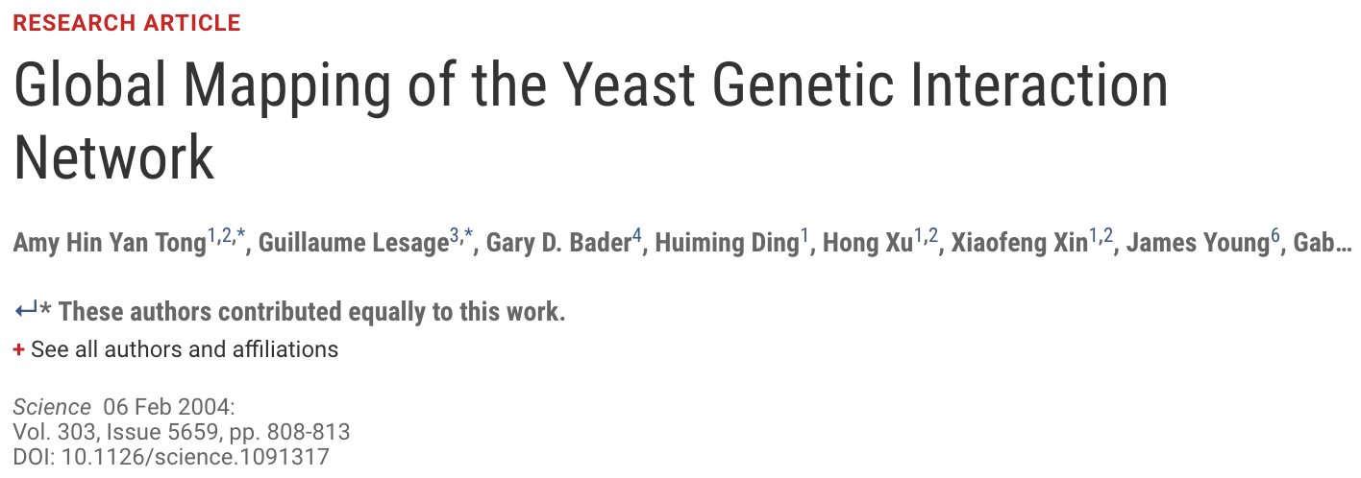
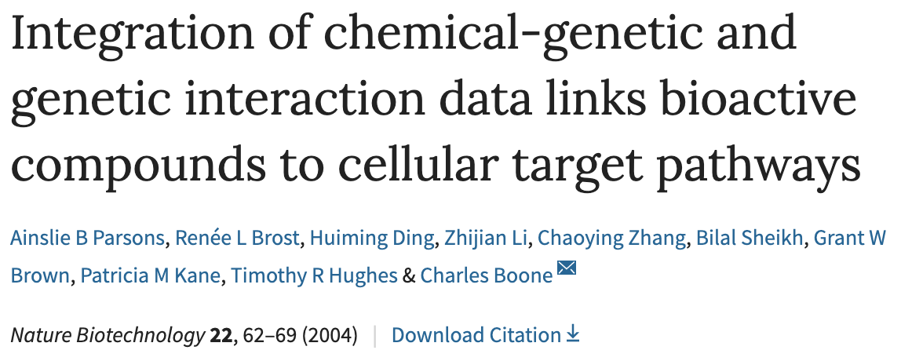
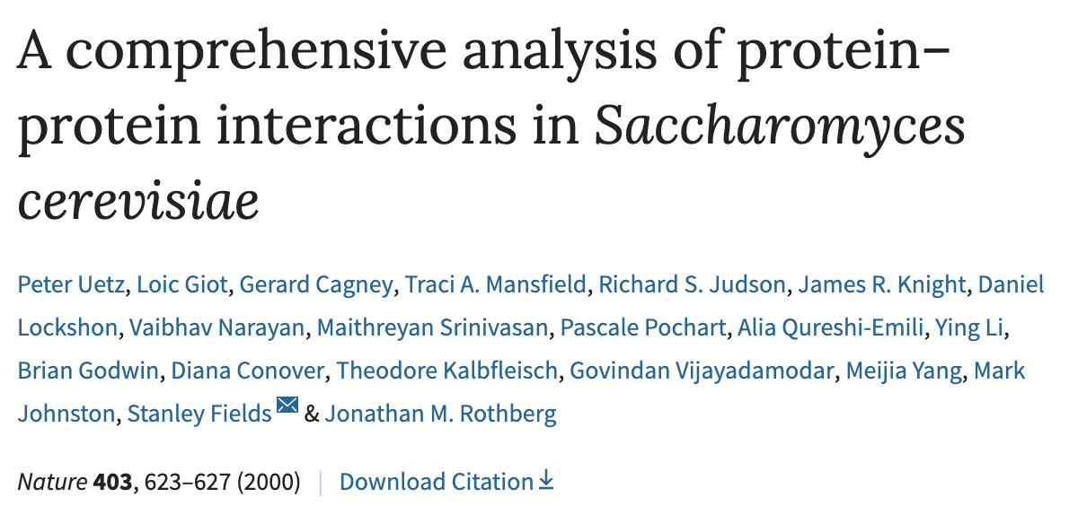
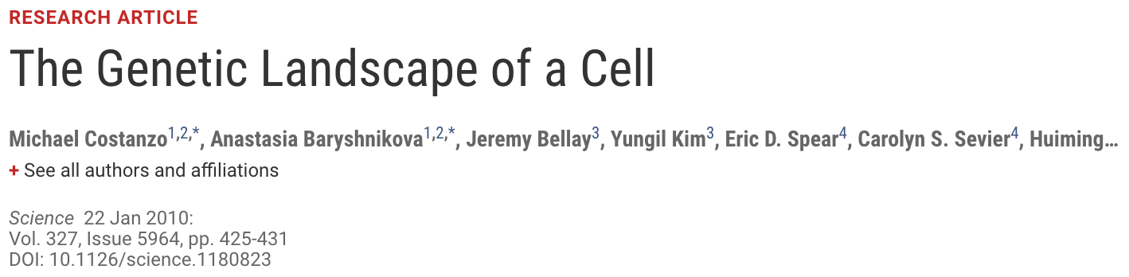

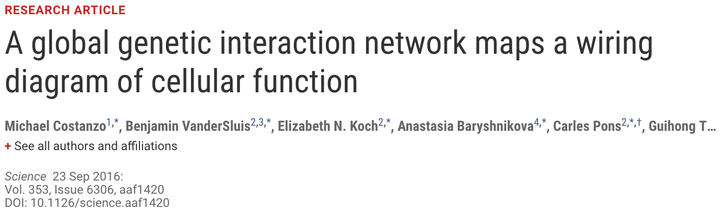
CBHTS have been used to identify…
Gene – gene
interactions
Gene – environment
interactions
Protein – protein
interactions
@saur1n
Notes:
Colony based high-throughput screens have been used to identify gene-gene, gene-environment, protein-protein interactions

Slide 5
CBHTS have been used to identify…
Gene – gene
interactions
Gene – environment
interactions
Protein – protein
interactions
But their use in evolutionary biology has been limited!
@saur1n
Notes:
But their use in evolutionary biology has been limited!

Slide 6
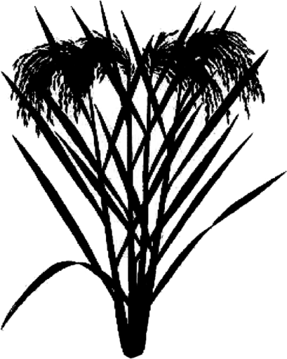
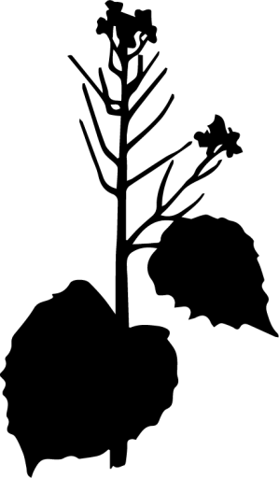




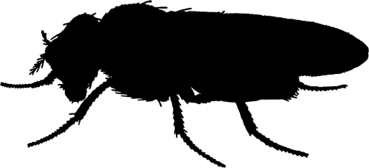

CBHTS can reveal evolutionary phenomena
Saccharomyces Oryza Brassicaceae Arabidopsis Drosophila Mus Pan Homo
de novo gene birth
Noncoding Sequence
Gene
@saur1n
Notes:
Where in fact we believe they can be used to reveal interesting evolutionary phenomena!
Like we’ve known from recent work that all sequenced genomes contain numerous coding sequences that evolved recently from non-coding regions.

Slide 7
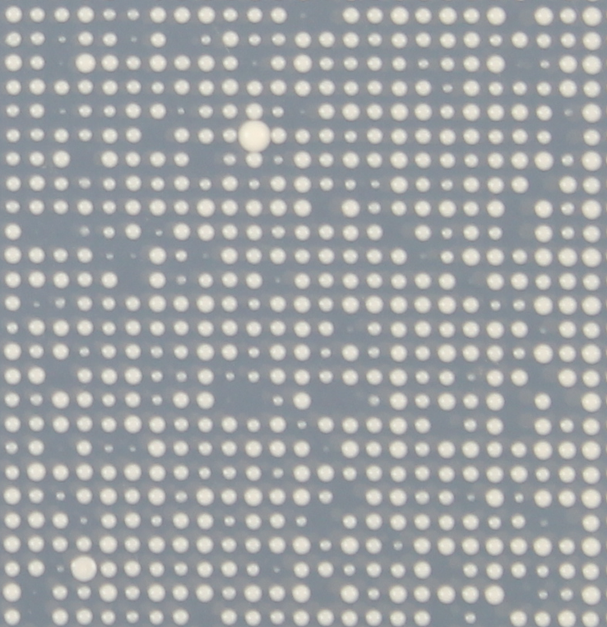
CBHTS can reveal evolutionary phenomena
Saccharomyces
Overexpression
Adaptive
Deletion
Deleterious
@saur1n
Notes:
By characterizing if their over-expression or deletion is either adaptive or deleterious to the organism, colony-based high-throughput screens can shed light on their potential functionality

Slide 8
Correcting for spatial bias ends up ignoring small fitness effects
“The environment can rarely be maintained constant across plates”
- Zackrisson et al. 2016
@saur1n
Notes:
However a reason why such implementations haven’t been done before is because correcting for spatial bias ends up ignoring the small fitness effects that are expected in an evolutionary context!
The environment can rarely be maintained constant within a single plate, let alone across multiple plates. Leading to systematic colony growth differences that arise due to technical reasons rather than biological ones.

Slide 9
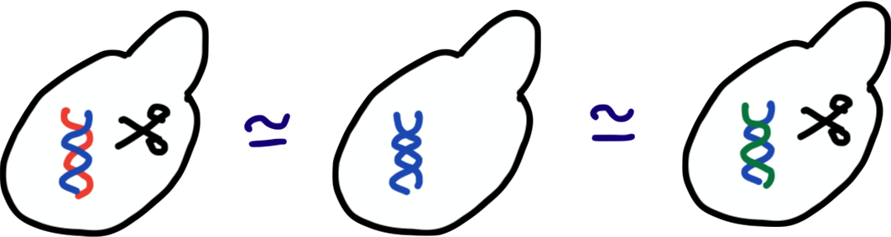
Correcting for spatial bias ends up ignoring small fitness effects
Existing Methods For Spatial Bias Correction
Collins et al. 2006, Wagih et al. 2013, Young et al. 2013, Bean et al. 2014, Zackrisson et al. 2016
Assumptions
1.
@saur1n
Notes:
Existing methods that correct for these biases assume that most genetic perturbations have minimal effects on fitness and…

Slide 10
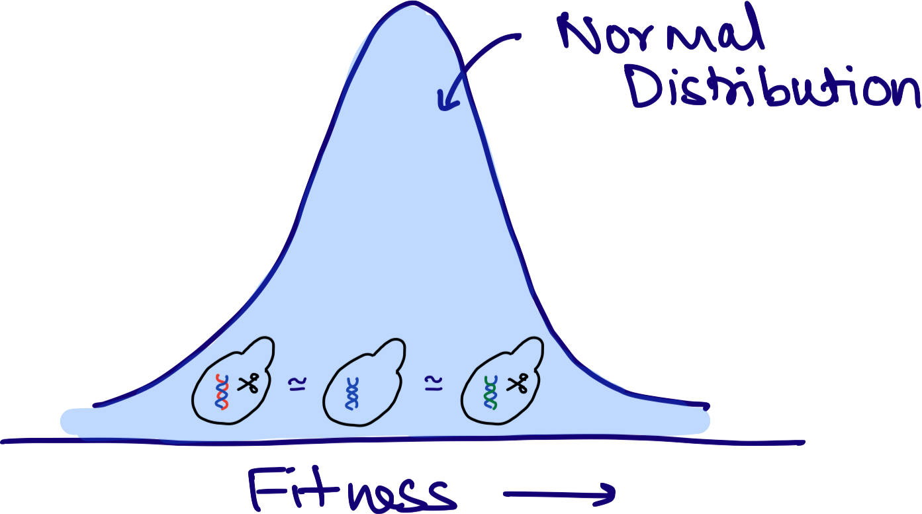
Correcting for spatial bias ends up ignoring small fitness effects
Existing Methods For Spatial Bias Correction
Collins et al. 2006, Wagih et al. 2013, Young et al. 2013, Bean et al. 2014, Zackrisson et al. 2016
Assumptions
1.
2.
@saur1n
Notes:
…that most screens would contain a normal distribution of fitness effects.
Both these assumptions end up correcting against small fitness effects.

Slide 11
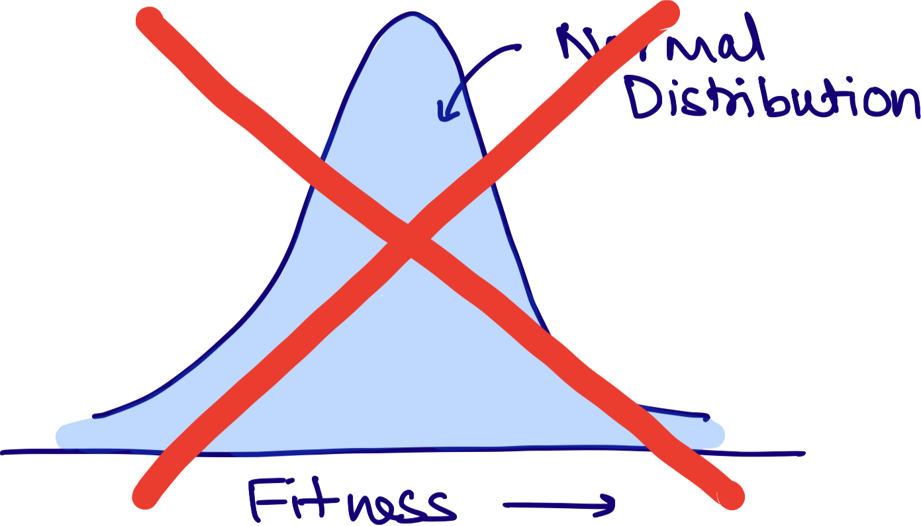
LI Detector reveals the truth!
@saur1n
Notes:
So we designed the LI Detector to reveal the truth about small effects!
1. It makes no assumptions of the underlying fitness distribution

Slide 12
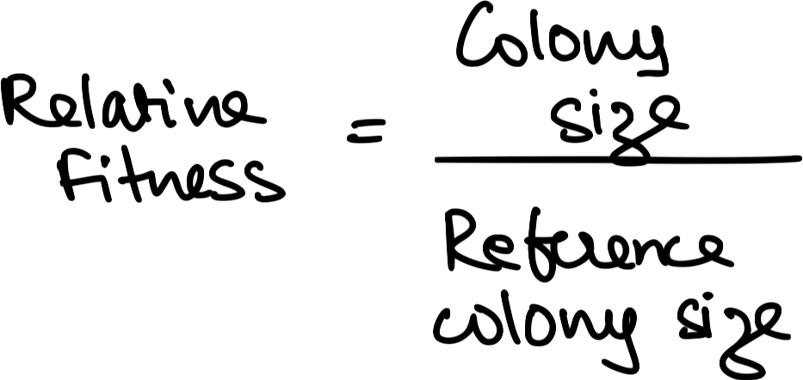
LI Detector reveals the truth!
@saur1n
Notes:
2. Assigns relative fitness to every colony as its size compared to the references

Slide 13
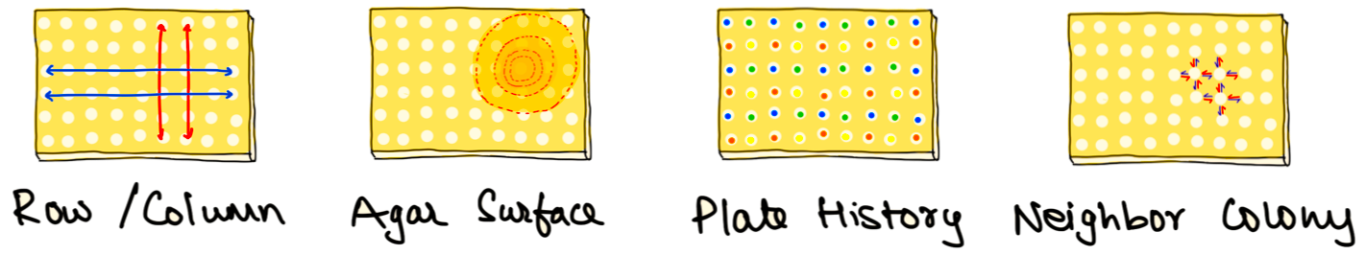
LI Detector reveals the truth!
@saur1n
Notes:
3. Uses a references colony grid to remove variety of spatial biases

Slide 14

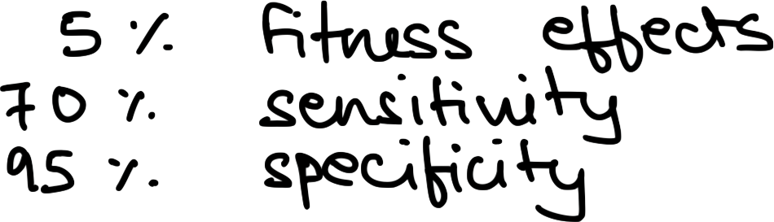
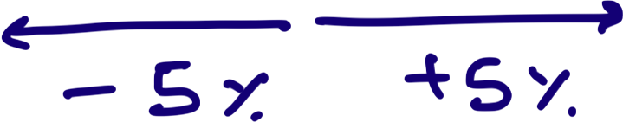
LI Detector reveals the truth!
@saur1n
Notes:
4. Is able to detect fitness effects as low as 5% with 70% sensitivity and 95% specificity

Slide 15
LI Detector can expand the use of CBHTS
Relative fitness makes across plates comparisons more accurate
No limits on the number of mutants in a screen
Specifically designed to detect both adaptive and deleterious fitness
@saur1n
Notes:
With that we believe the LID detector can expand the use of CBHTS
1. By making across plates comparison more accurate
2. Posing no limitation on the number of mutants in a screen
3. And, by being equally sensitive towards both small adaptive and deleterious fitness effects.

Slide 16
LI Detector can expand the use of CBHTS
Relative fitness makes across plates comparisons more accurate
No limits on the number of mutants in a screen
Specifically designed to detect both adaptive and deleterious fitness
Endless possible experimental setups!!
@saur1n
Notes:
This combined with the inherent advantages of high throughput screens makes for endless possible experimental setups!
So if you think the LI Detector can help you in your research or are interested in finding out more, come talk to me afterwards or reach out on social media.

Slide 17
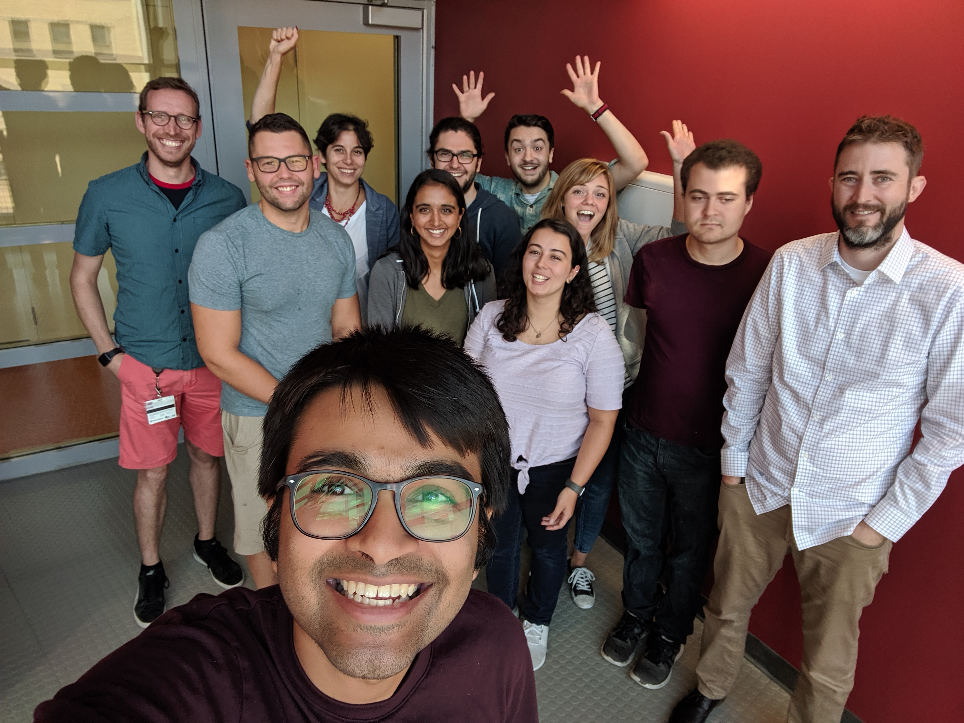
Thank You!
Carvunis Lab
Anne-Ruxandra Carvunis
Nelson Coelho
Aaron Wacholder
Branden Van Oss
Carly Houghton
John Iannotta
Kate McCourt
Omer Acar
Summer’19
This work was supported by: funds provided by the Searle Scholars Program to A-RC; the National Institute of General Medical Sciences of the National Institutes of Health grants R00GM108865 awarded to A-RC.
@saur1n
Notes:
Finally I would like to thank all the lab members who have helped me develop this method and to the organizers for giving me this opportunity to showcase my work in front of this community.
With that I would like to take your questions.

